Slide 1
Crop2ML: An open-source, multi-language modeling framework for the exchange and reuse of crop model components
Cyrille Midingoyi, PhD (LEPSE - INRAE)
Cyrille.midingoyi@inrae.fr
Montpellier, France
Christophe Pradal, Andreas Enders, Davide Fumagalli, Hélène Raynal, Marcello Donatelli, Ioannis N. Athanasiadis, Cheryl Porter, Gerrit Hoogenboom, Dean Holzworth, Frédérick Garcia, Peter Thorburn, Pierre Martre

Slide 2
Problem Statement

Slide 3

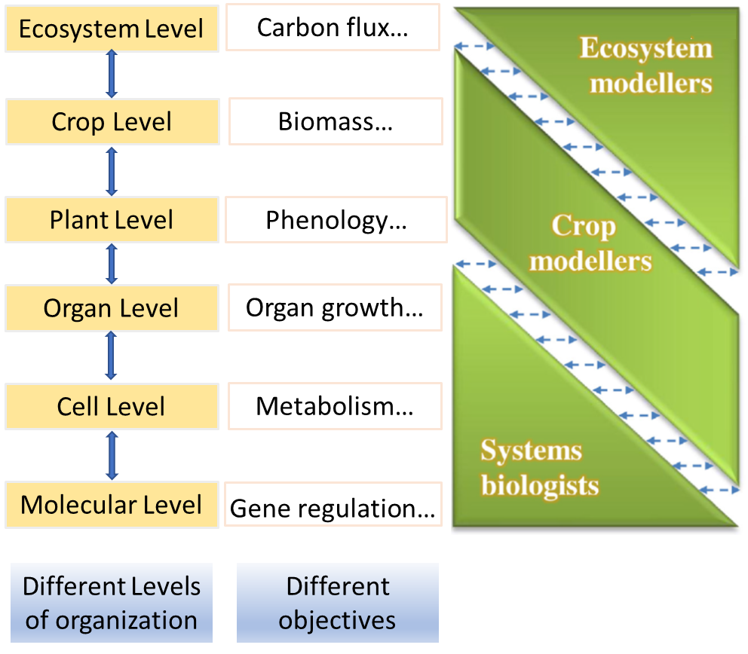
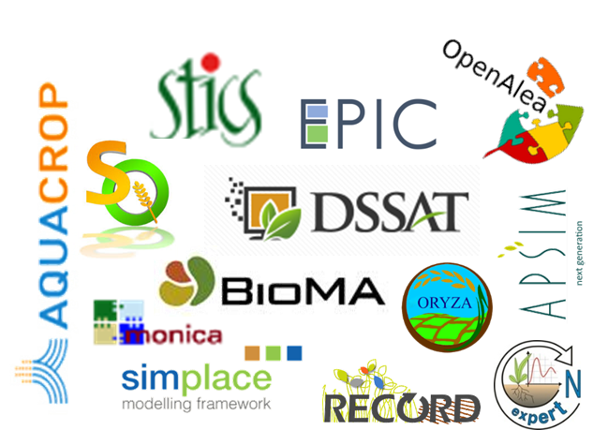
Process-based crop models developed with modeling frameworks
Simulation models are popular tools to analyze and predict plant and crop development and growth from molecular to ecosystem levels
+40 wheat models in use (AgMIP)
Chew et al., 2017 FCR

Slide 4

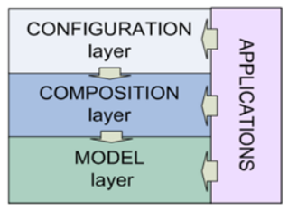
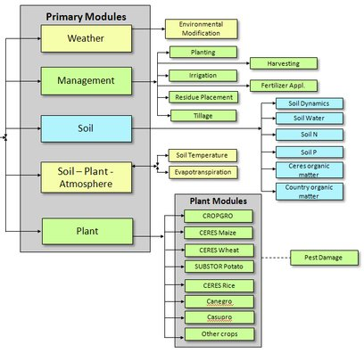


Some Process-based crop modeling frameworks
Atomic / Coupled Models
Analysis

Slide 5
New challenges in PBM modeling and simulation
Scientific Challenges
Analyze models at the process-level
Integrate new biological knowledge in crop models
Communities Challenges
Exchange and reuse model components between different modeling platforms

Slide 6
Benefits and limitations of crop modeling frameworks
Crop modeling frameworks:
A large community since more than 30 years
Facilitate model development and reuse
Based on a component-based approach (phenology, water balance, …)
However, the reusability of models has also proved to be modest:
Have a rigid structure (architecture)
Require high-level programming skills to make changes
Have limited modularity (careful definition of interfaces)
Lack of standardization toward few frameworks (Donatelli et al, 2012)
Faced with the heterogeneity of crop modeling frameworks, how to automatically reuse model components between different frameworks?

Slide 7
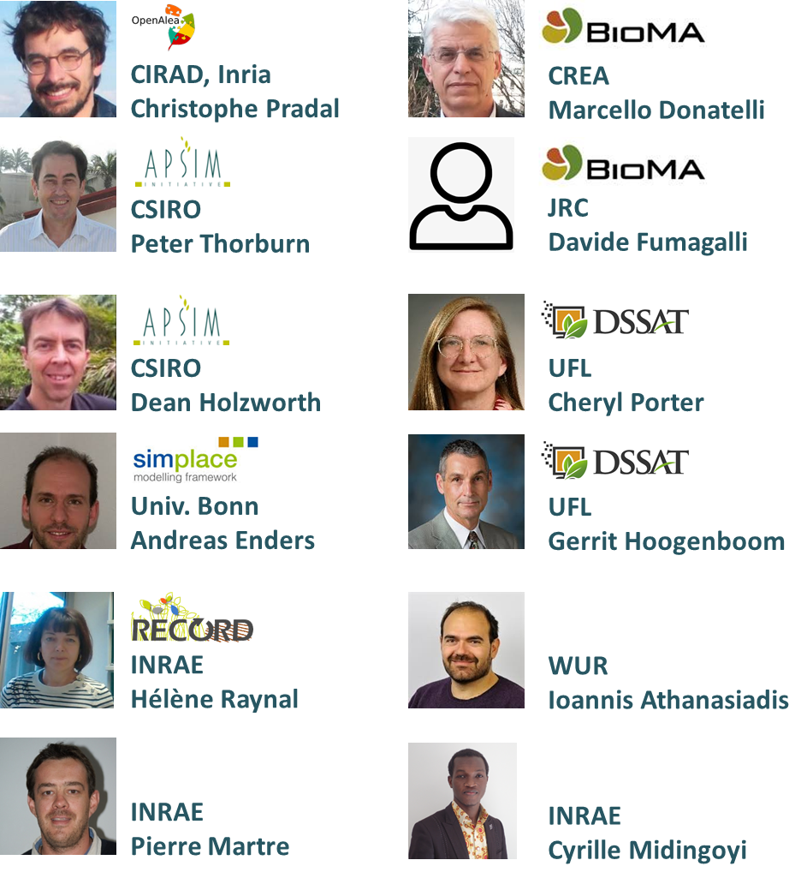
The Agricultural Model Exchange Initiative (AMEI)
Vision
Group of crop modelers sharing a common vision to advance agro-environmental research via the use of models.
To Propose a solution to the crop modeling community for NextGen crop modeling tools
AMEI past hands-on workshop
Gainesville, USA – Feb. 2015
Toulouse, FR – Jul. 2016
Bologna, IT – Jul 2016
Paris, FR – Oct.2017
Rome, IR – Mar. 2018
Bonn, GE – Jul. 2018
Montpellier, FR – Nov. 2018
Toulouse, FR – Feb. 2019
Gainesville, US – Apr. 2019
Montpellier, FR – Oct.2019

Slide 8
Use Case

Slide 9

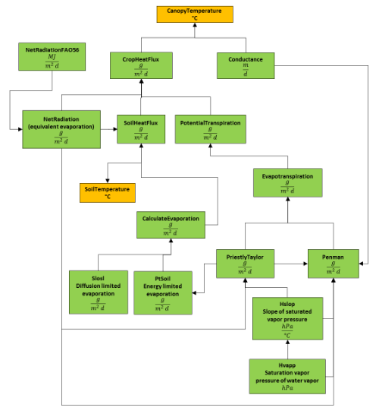

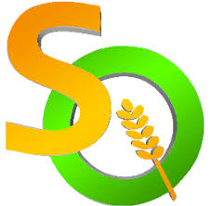

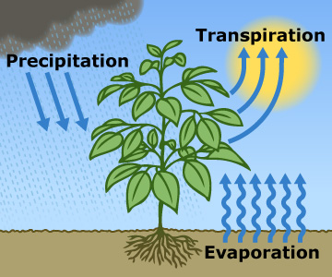



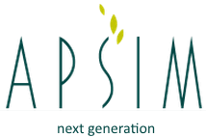
Use case
Energy Balance

Slide 10
Use case

Slide 11
Approach

Slide 12

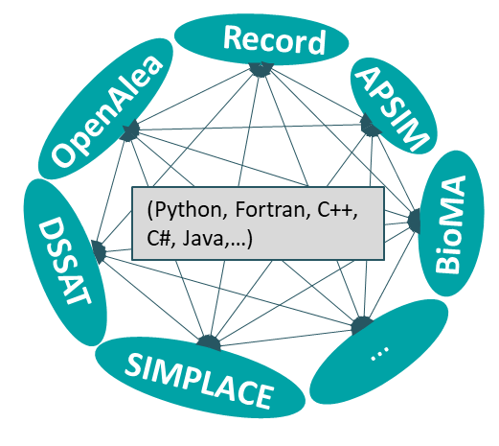

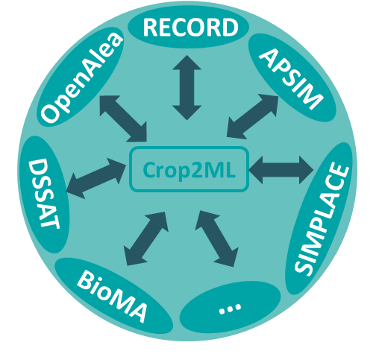
Provide an efficient approach for model component exchange and reuse between crop modeling platforms:
Transparent (white-box approach)
“Free-form” modularity (no careful definition of interfaces)
Centralized framework to generate platform specific models
Takes into account existing platforms specificities
Conform to FAIR principles: Findable, Accessible, Interoperable, Re-usable

Slide 13
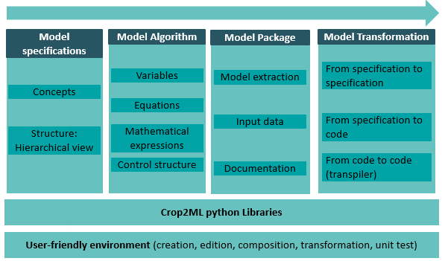
Crop2ML generic crop modeling framework
1
2
3
4

Slide 14
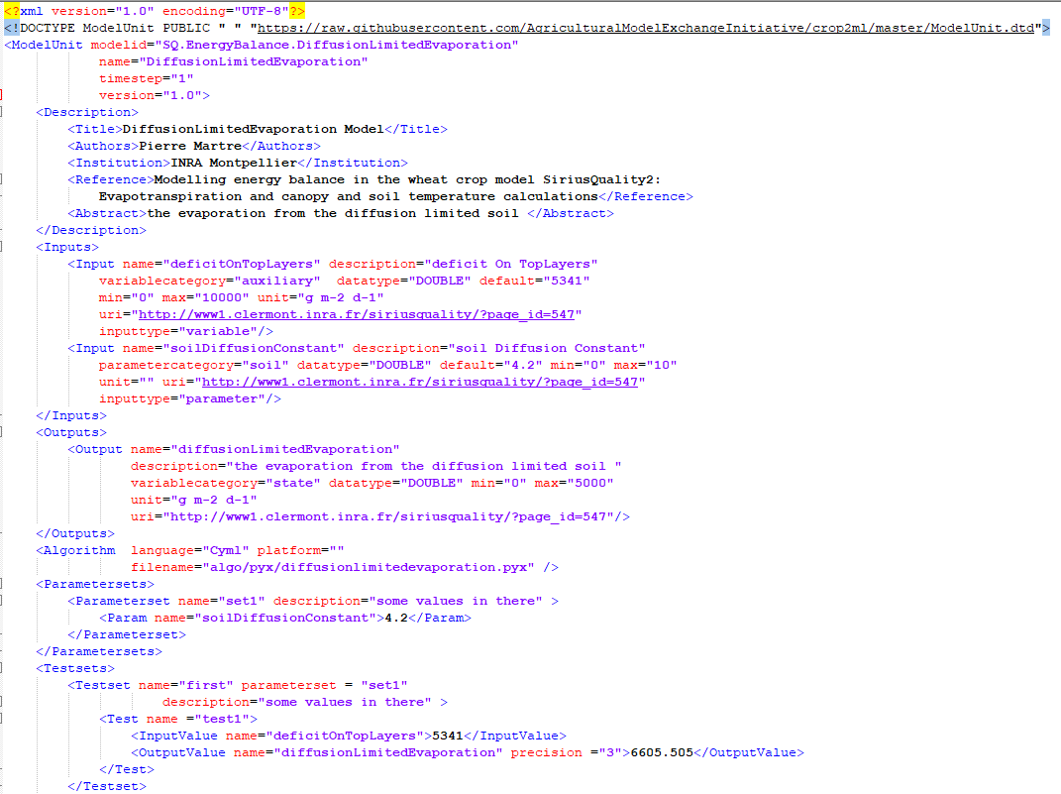
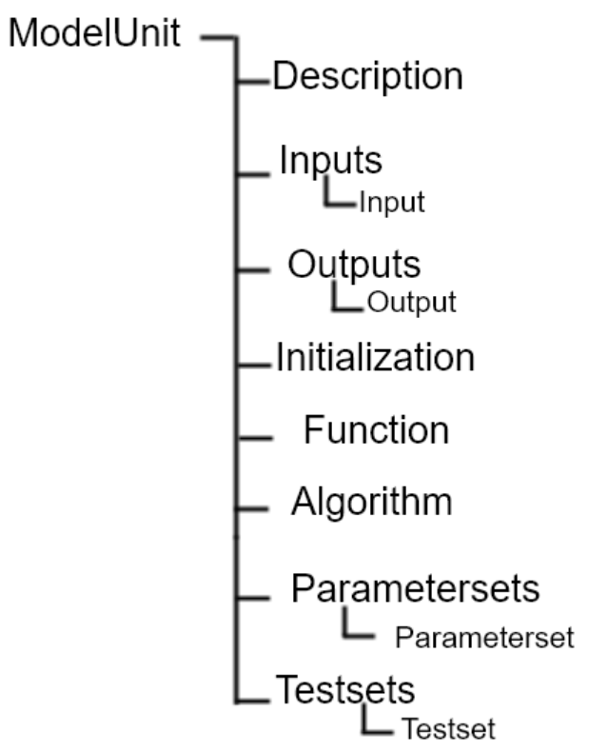
1
Formalism of Crop2ML Model specification
ModelUnit

Slide 15
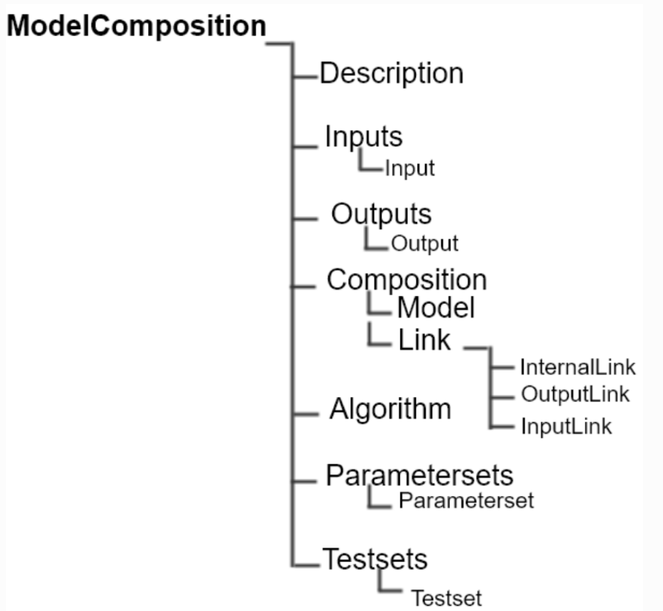
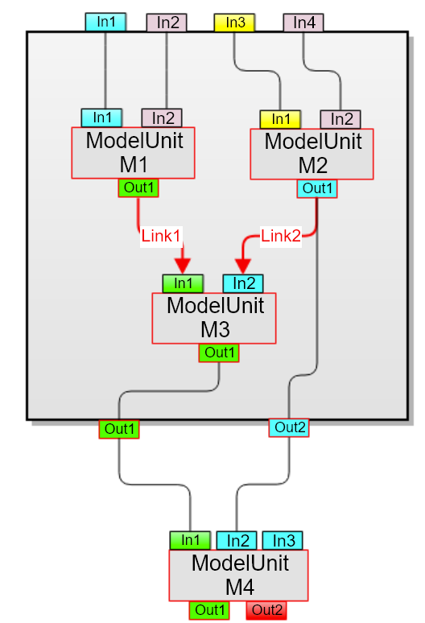
1
Formalism of Crop2ML Model specification
ModelUnit
ModelComposite
Example of a model composite

Slide 16
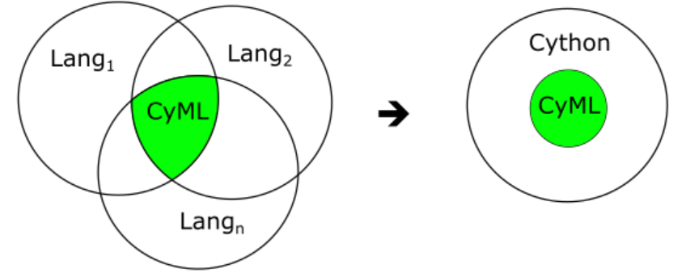
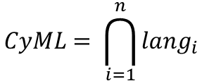
Approach
2
CyML : A minimal language for crop model algorithms
Design choices
Not from scratch
Gentle learning curve
Compatibility with existing languages
Features
Lang = (Fortran, C++, Java, C#, R, Python)
CyML is an extensible subset of Cython (Python + C types) to represent algorithms of biophysical processes.
Modular (function, module, package)
Base types (integer, real, string, boolean), list, array, datetime
Control structures (if elif else, for, while) / finite difference equations
Provides standard functions
$$CyML= \bigcap_{i=1}^{n}{{lang}_{i}}$$

Slide 17
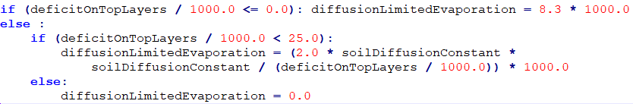
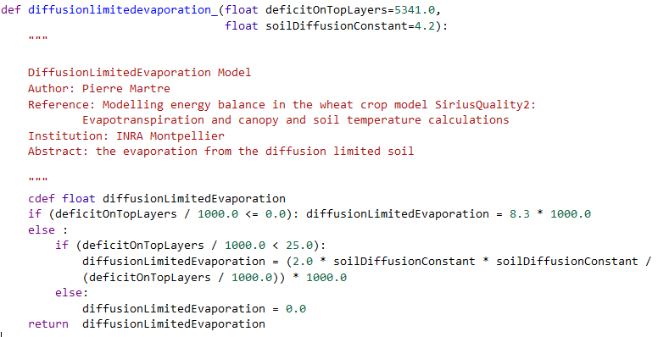
2
CyML : A minimal language for crop model algorithms
An example of Model specification
Model Algorithm
CyML source code

Slide 18
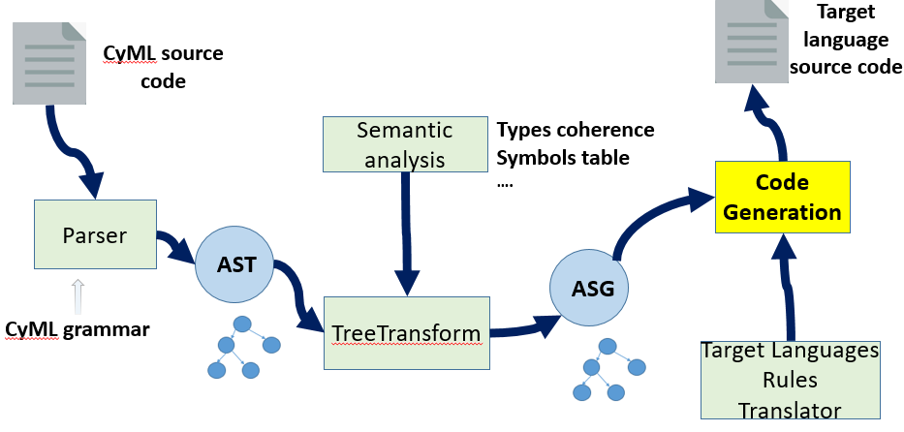

3
Transformation system from Crop2ML to crop modeling platforms
An Abstract Syntax Tree is a data structure that represents the syntactic structure of the source code as a tree
An Abstract Semantic Graph is a mathematical representation of the source code from the refinement of the AST with semantic information
Framework
component
Adaptator
Cython grammar
Abstract
syntax tree
Abstract
semantic graph
Fully automatized language conversion workflow (CyMLT transpiler)

Slide 19
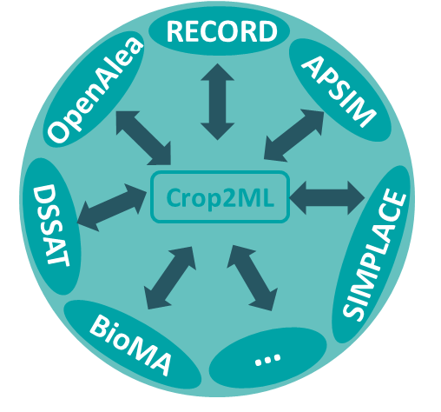

3
Transformation system from Crop2ML to crop modeling platforms
  Integration of platform specificities
XML / O-O
Java
FWSimComponents
XML / O-O
C#
Domain Classes
Strategy classes
Automatic Conversion frameworks
Fortran
Procedural
Subroutines
Modules
Discrete-event
C++
VLE package
Data Flow
Python
Nodes (Factory)

Slide 20
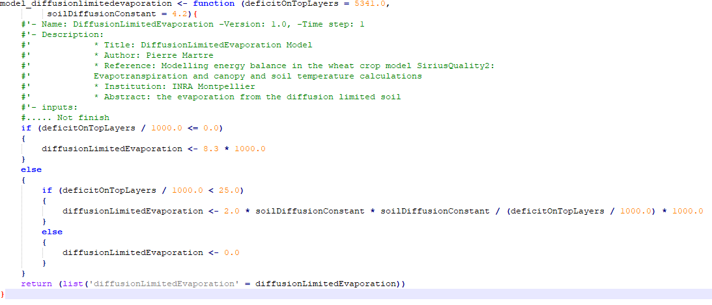
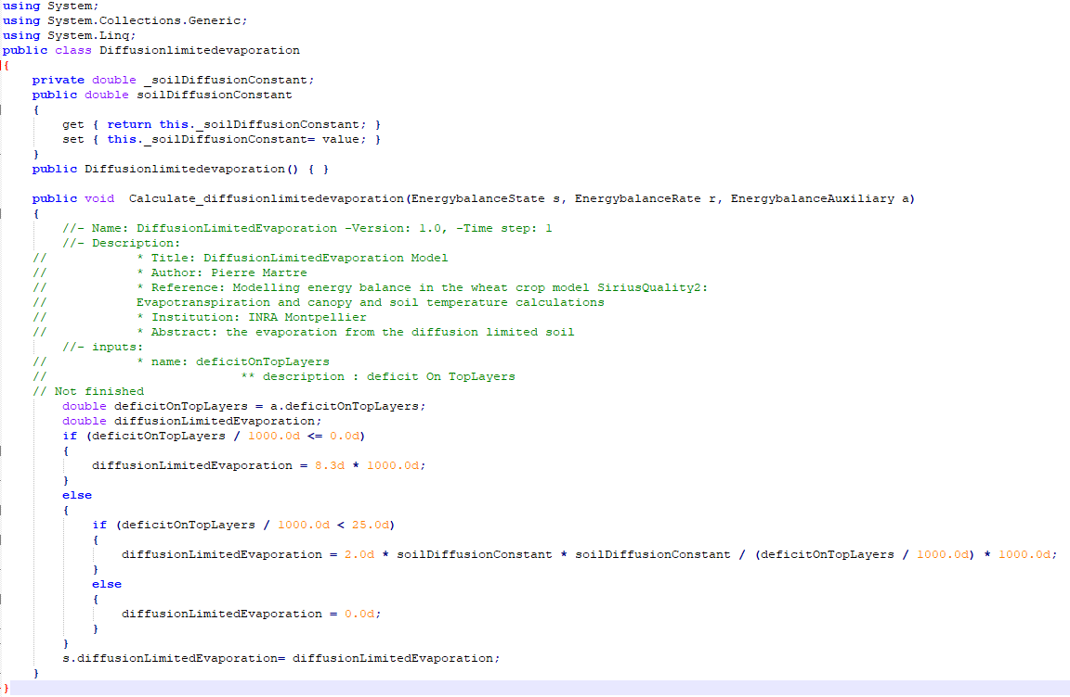
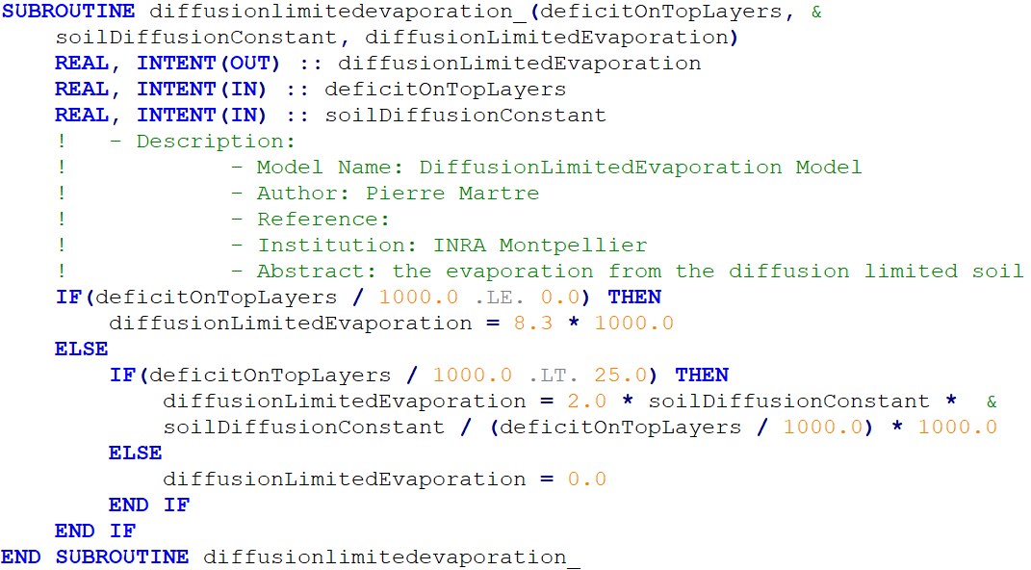
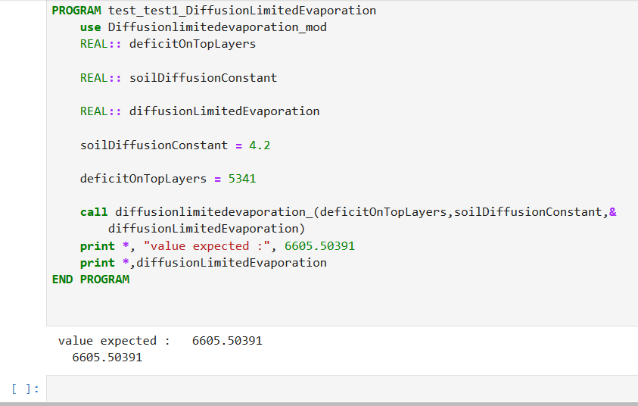
3
Transformation system from Crop2ML to crop modeling platforms
Code transformation from CyML to R
Code transformation from CyML to Fortran
Code transformation from CyML to SiriusQuality(BioMA)
Unit test transformation in Fortran

Slide 21
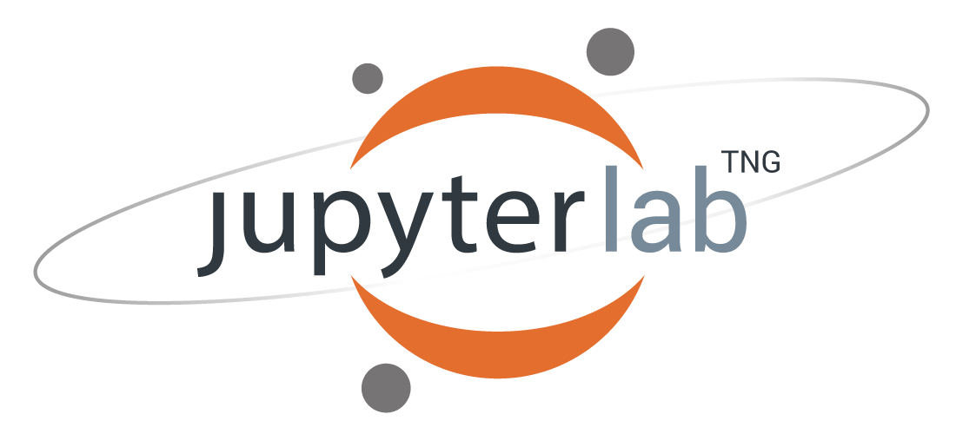
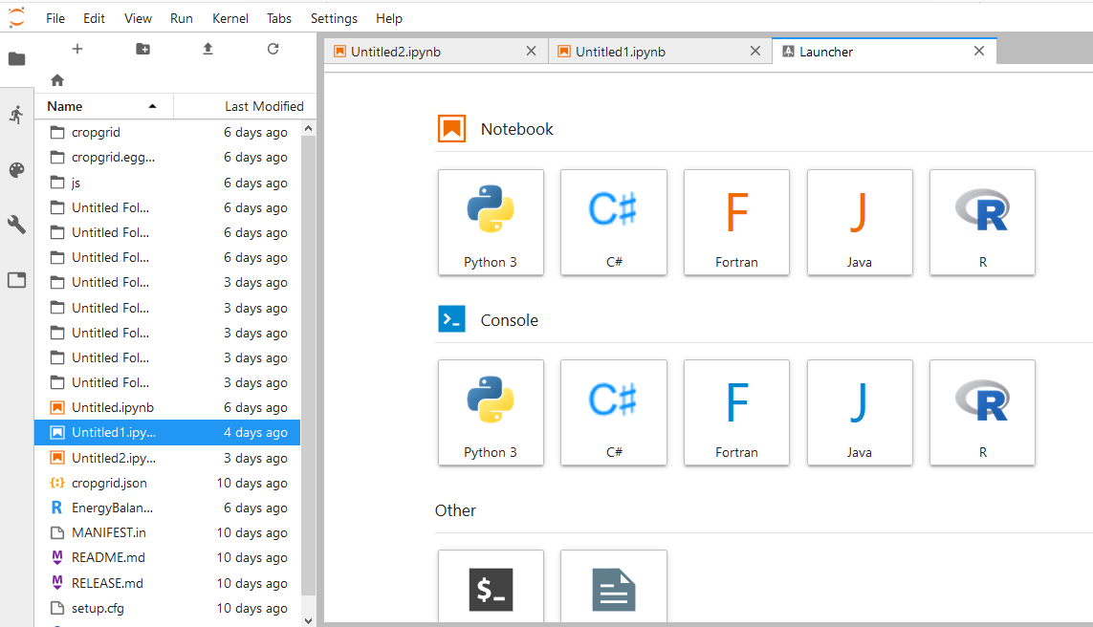
4
  CropMStudio and proof of concepts

Slide 22
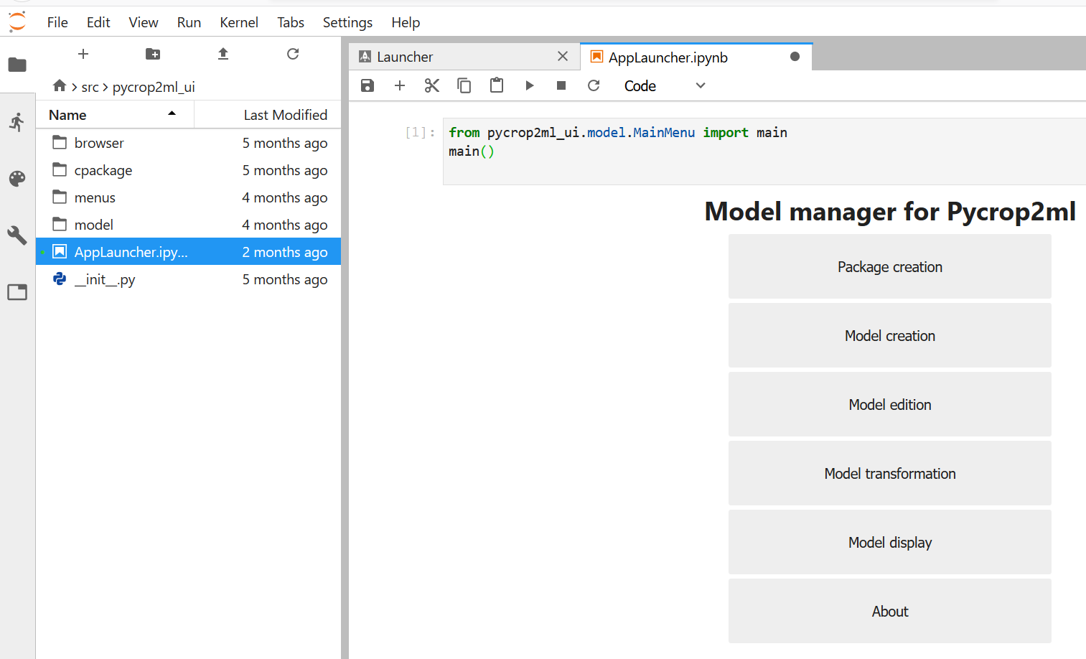
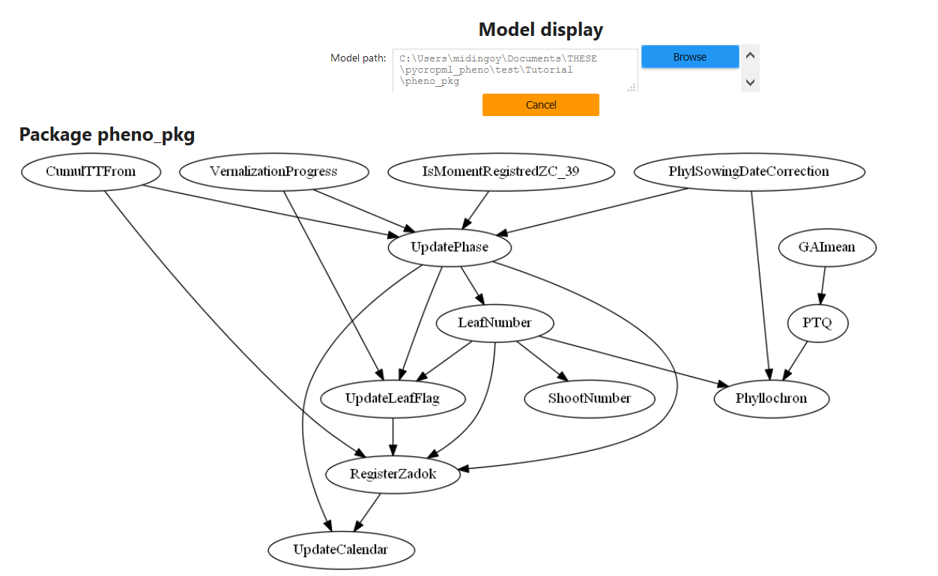
4
  CropMStudio and proof of concepts
Create
Edit / transform
Visualize

Slide 23
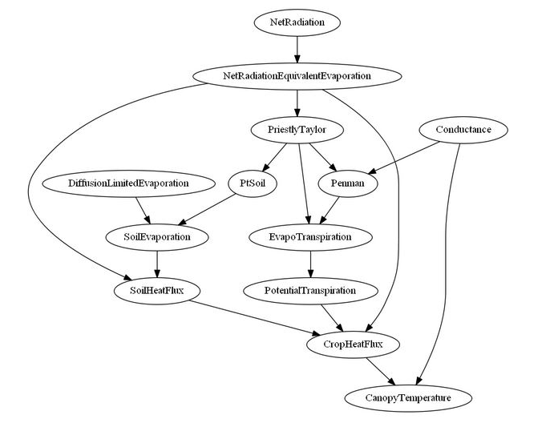
4
  CropMStudio and proof of concepts
Energy balance model component in SiriusQuality model developed in BioMA

Slide 24
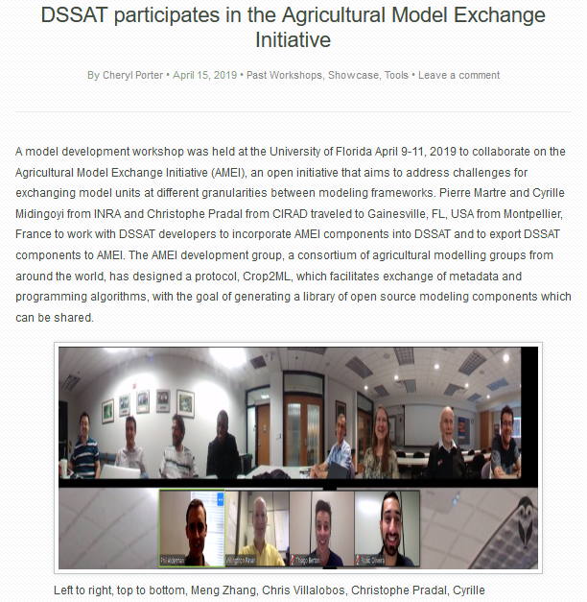
4
  CropMStudio and proof of concepts
Incorporating Energy Balance from BioMA into DSSAT through Crop2ML
Few manual addition:
Link with data
Simulation loop

Slide 25
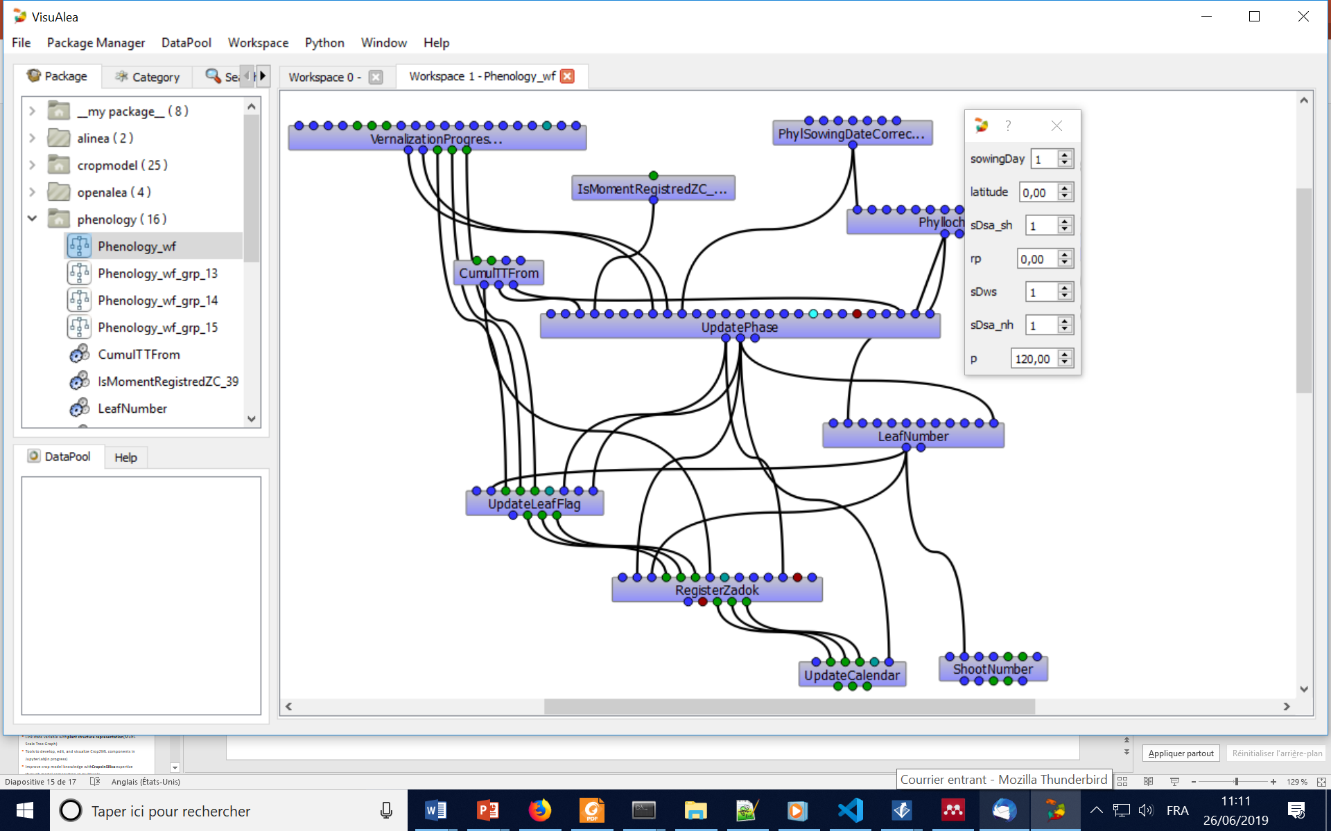
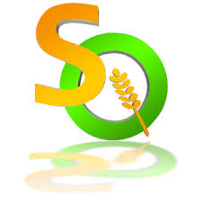



4
  CropMStudio and proof of concepts
Phenology
Energy Balance
Snow
Pradal et al., 2008
Crop2ML
Algorithm only in Cyml
Enders et al., 2010
Phenology
Energy Balance
Snow
Bergez et al., 2013 EMS
Crop2ML
Package
Donatelli et al., 2012 iEMS
Transpiler
Crop2ML
Src/Test generated in F90, C#, C++, Py
Phenology
Energy Balance
Snow
Jones et al., 2003 EJA
Phenology
Energy Balance
Snow
Brisson et al., 1998 Agronomy
Semi-automatically
Automatically
McCown et al., 1996 Agri. Syst.

Slide 26
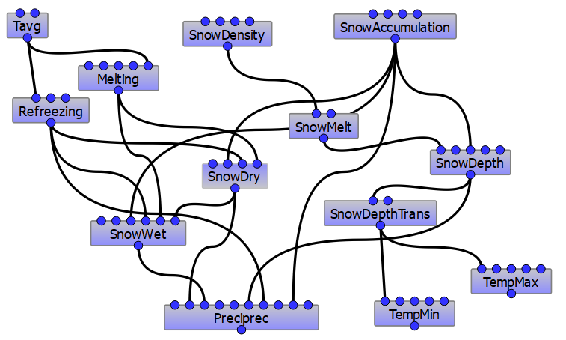
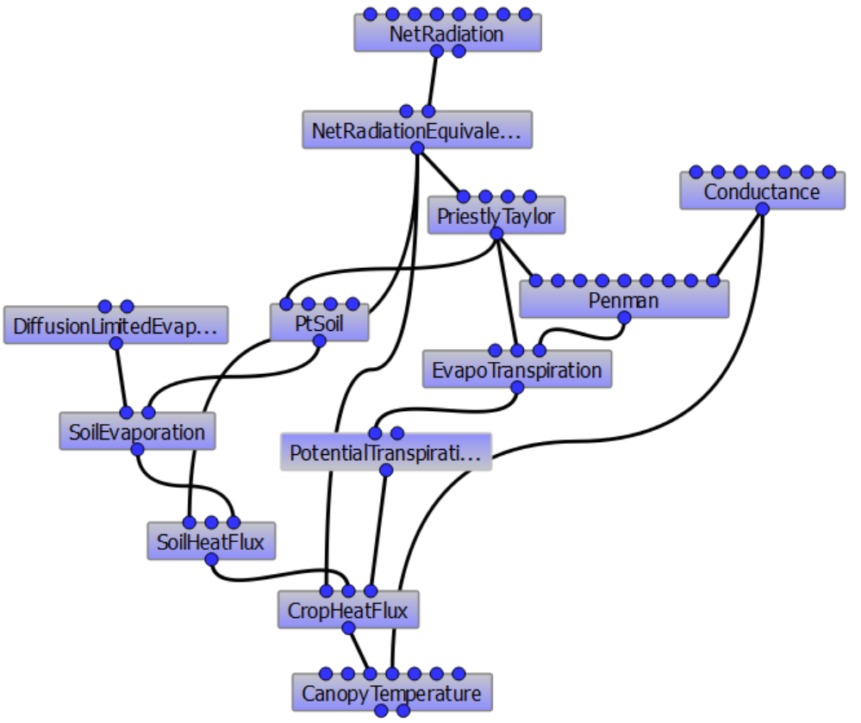
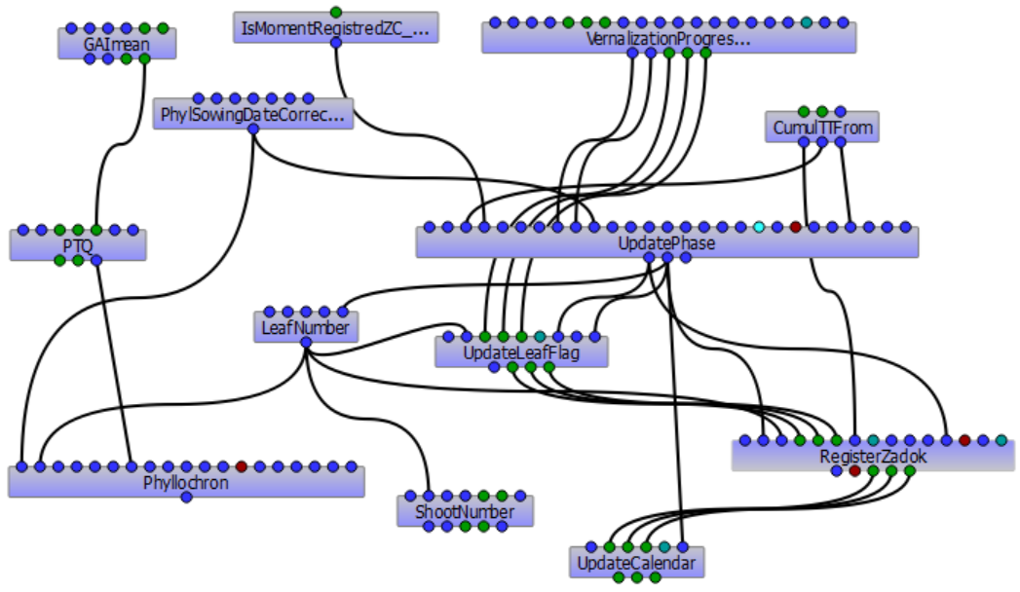
4
  CropMStudio and proof of concepts
  Energy balance
  Snow
  Phenology

Slide 27
Limitations / Perspectives

Slide 28
  Some improvements
P1* Automatic transformation system from crop modeling platforms to Crop2ML
How?
      Transform Platform model component into a common ASG and generate the code from it
      Infer Crop2ML model specifications
Interest
  Facilitate reuse with existing components
  Maintenance and Update
P2* Crop2ML Models Repository
How?
      Develop a Web application with relational database
Interest
Increase collaboration and model component sharing

Slide 29
  Some improvements
P2* Enhance the integration of PBMs across different languages and scales
How?
    Link Crop2ML with other model reuse initiatives (Crops In Silico, SBML, …)
Interest with Crops In Silico
make available model components into the languages supported by Yggdrasil (Lang, 2019) with their wrappers
produce efficient components source code in various languages in order to improve the performance of the simulation in Yggdrasil
validate each component with unit tests before their integration
P3* Address Semantic compatibility
How?
    Common Ontology
    Model to model dictionary
Interest to address semantic compatibility
Support platforms interoperability

Slide 30
  Some improvements
It is an ongoing, long-term activity, to satisfy platform requirements and facilitate Crop2ML model life-cycle management to make Crop2ML a standard for the plant and crop modeling community.
  For further information
Reuse of process-based models: Automatic transformation into many programming languages
and simulation platforms. in silico Plants, diaa007.
https://doi.org/10.1093/insilicoplants/diaa007
Crop2ML: An open-source multi-language modeling framework for the exchange and reuse of
crop model components. Environmental Modelling & Software.
https://doi.org/10.1016/j.envsoft.2021.105055

Slide 31

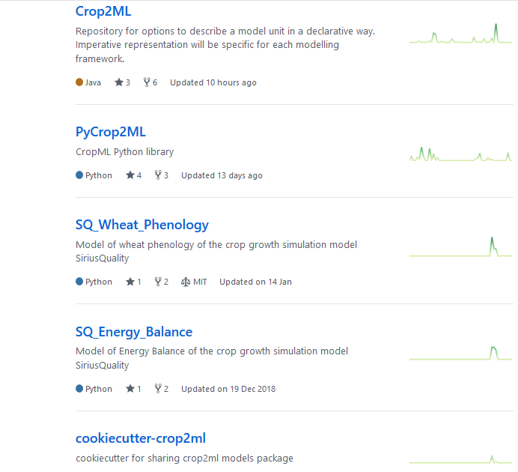
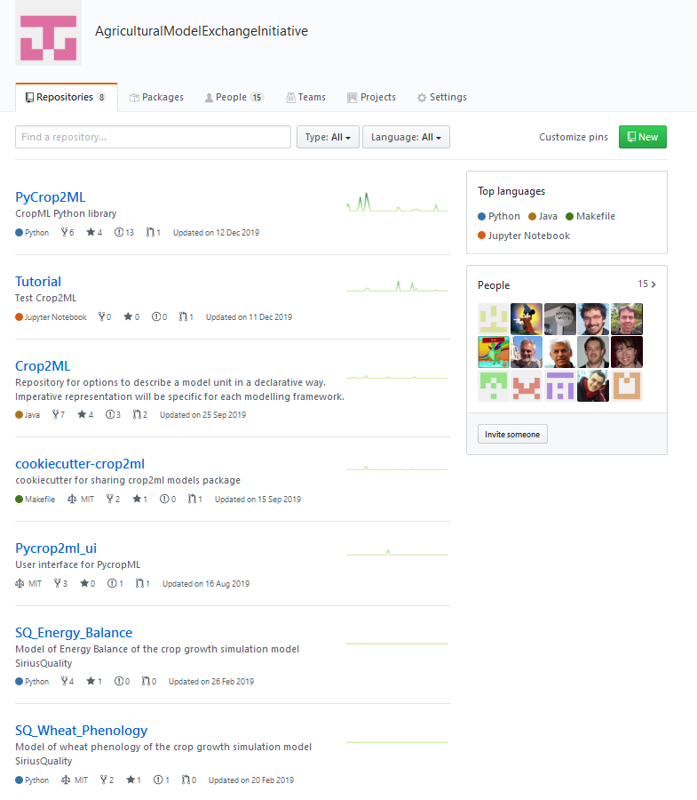
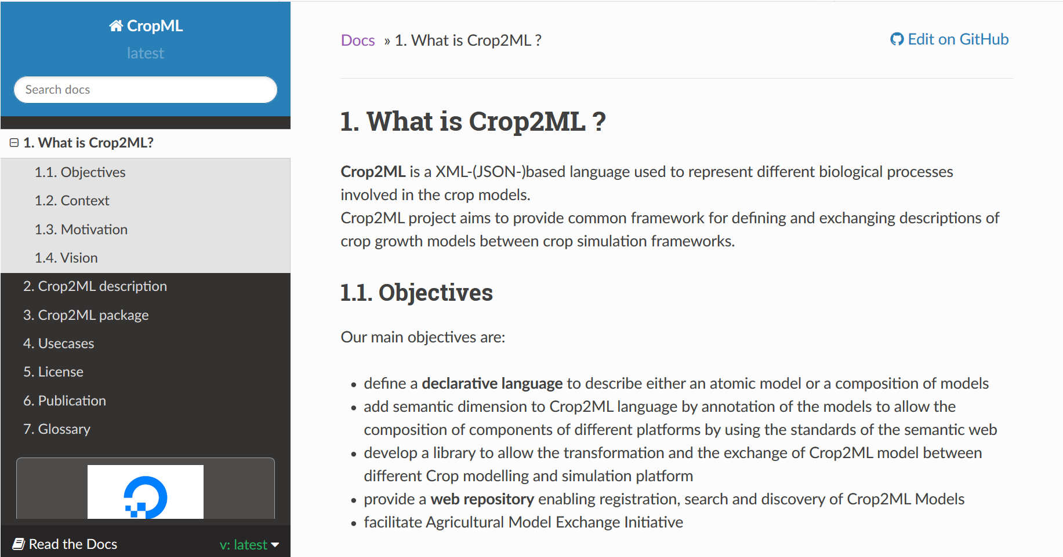
Become an AM(E)I !
https://github.com/AgriculturalModelExchangeInitiative/
Follow and contribute to Crop2ML development on GitHub

